Slide 1

Response Curves and Action Inertia in Utility-Based NPC Agents
Wenjie Jiang
Advisor: Navid Amini, PhD
August 2026

Slide 2
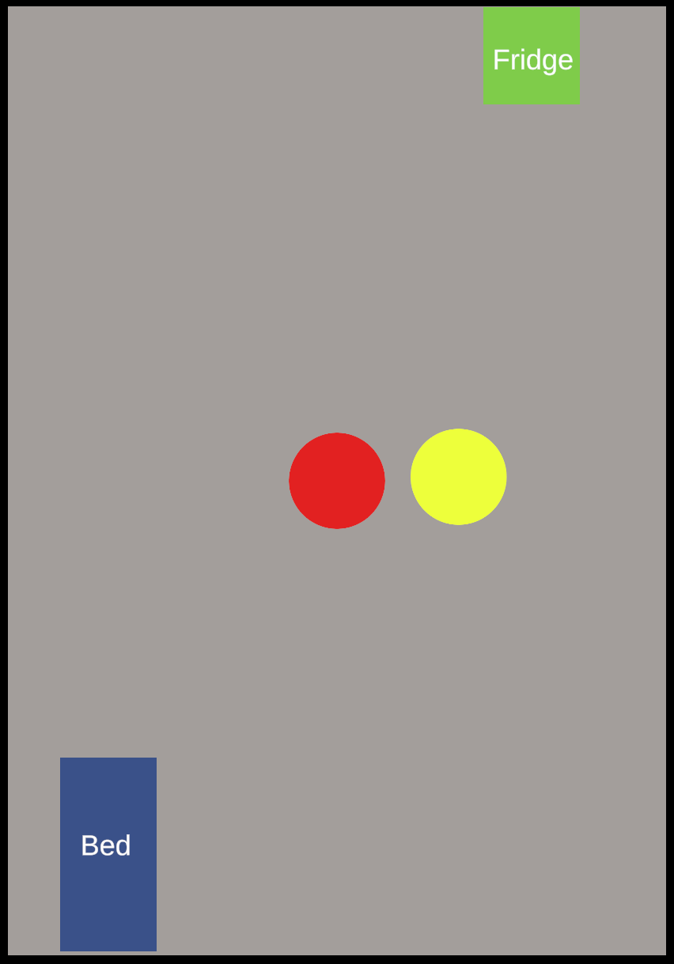
The Overall Project Scope and Objectives
Scope
2D Unity simulation, single-room greybox environment
Two agents sharing identical bodies, differing in decision brain
Shared needs: hunger and energy
Objectives
We compare a baseline threshold agent (rigid) against a utility-scored agent (fluid) across stability and adaptability metrics
Stability — consistent behavior, preventing behavioral oscillation between actions
Adaptability — dynamically adjusts behavior when resources are removed

Slide 3
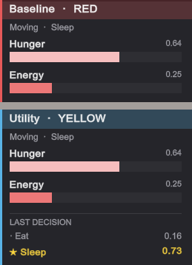
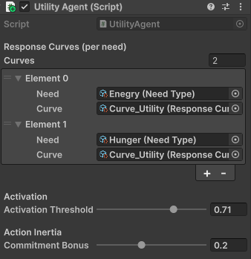
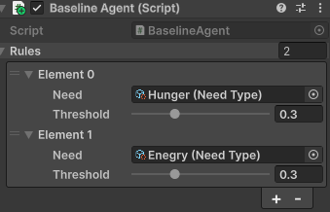
Proposed Methodology and Technical Approach
Experimental Method
Same body, different brains — measured on stability and adaptability
Baseline — priority-ordered threshold rules
Utility — response curves + action inertia (highest-scoring action wins)
Technical Approach
Swappable brain component — same body, plug in Baseline or Utility
ScriptableObject data layer — Needs, Curves, Smart Objects
Pull-based perception — agent scans world each decision cycle

Slide 4
Expected Challenges and Risks
1. Inertia Tuning:
Too strong → agent sleeps through survival emergencies
Too weak → agent jitters between actions every cycle
Action inertia is a score bonus on the currently-active action in the utility agent
2. Metric Validity:
Stability → can be gamed (idle agents score perfectly)
Adaptability → depends on how tests are designed (easy or hard scenarios yield no signal)
Stability and adaptability are numeric proxies for “believable behavior”

Slide 5
Review of Existing Work in this Area
Emergent NPC decision-making:
aims for stable, adaptive behavior without a scripted response for every situation
Two Dominant Approaches
Lightweight / Classical (Utility AI) | Heavy / Generative (LLM-driven agents)
Agents score each action mathematically, pick the highest Textbook defines response curves and action inertia, but never tests how much each one contributes | LLM agents plan, remember, and socialize believably (25-NPC sandbox study) Each decision is a cloud API call, making the approach expensive and non-reproducible
(Mark, 2009)
(Park et al., 2023)

Slide 6
How Our Approach Addresses Limitations of Existing Models
Our approach aims to address this limitation by empirically isolating response curves and action inertia
Utility AI Foundations | Our Approach
Response curves: math mapping need to desire | Baseline vs. curves-only: measures the curve's contribution
Action inertia (decision momentum): commitment bonus on active action | Baseline vs. inertia-only: measures inertia's contribution
Established design tools; empirical isolation remains open | Full 4-condition ablation: quantifies each mechanism's effect on stability and adaptability
(Mark, 2009)

Slide 7
Potential Improvements over Current Techniques
We aim to move established utility AI from description to measurement
Mechanism contributions:
measure how curves and inertia each affect stability and adaptability
Interaction effects:
test whether curves and inertia compound, add, or interfere
Design guidance:
may suggest preliminary tuning cues for curves and inertia

Slide 8
Pilot Testing and Findings
The measurement pipeline is in use. Ten runs recorded, eight of them repeats of one corrected configuration.
Two design flaws were corrected:
the agents began acting at different need levels, and a shared action lock was
doing part of inertia's work
First measured effect:
at equal decision volume, the utility agent interrupted its own actions 24% less
often; the direction held in 8 of 8 repeats
The effect cannot yet be attributed:
curves and inertia varied together, so the result belongs to the pair rather
than to either mechanism
 | Baseline | Utility
Decisions | 46.0 | 45.5
Interruptions | 12.6 | 9.6
Interruption rate | 27% | 21%
8 repeats, 300 simulated seconds each

Slide 9
A Tentative Timeline for Completion
Completed
Spring 2026
Simulation foundation, swappable-brain architecture, both agents, live demo
Summer 2026
Measurement pipeline:
every decision logged, and every run records its full parameter set
Pilot runs:
10 recorded, 8 of them repeats of one corrected configuration
Fall 2026 Planned
Stability metric:
separate harmful oscillation from justified switching
Adaptability scenario:
resource removal, so competing needs actually arise
Seeded randomization:
sample across starting conditions, not timing noise
Four-condition ablation:
separate the curve's contribution from inertia's

Slide 10
References
Mark, D. (2009). Behavioral Mathematics for Game AI. Course Technology/Cengage.
Park, J. S., O'Brien, J. C., Cai, C. J., Morris, M. R., Liang, P., & Bernstein, M. S. (2023). Generative agents: Interactive simulacra of human behavior (arXiv:2304.03442). arXiv. https://arxiv.org/abs/2304.03442

